Slide 1
Improving Revenue Generation on
Catch the Pink Flamingo
Analytics-driven Approach & Findings
Presented by: Eugene Yan

Slide 2
Background
Catch the Pink Flamingo (abbreviated CTPF) is a highly-rated, cross-platform multiplayer puzzle game published by Eglence Inc.
From the technical perspective, CTPF features a robust backend infrastructure that enables aggregation of data on player in-game behavior and social interactions.
Eglence Inc. intends to harness the potential of this captured data to explore opportunities in improving revenue generation from CTPF.
Notes:
Let’s start off with a little background on Catch the Pink Flamingo.
It is a high-rated, cross-platform multiplayer puzzle game that was published in 2015, boasting a huge player base from all around the world.
Whilst its public success belies in its simple yet addictive team-based play mechanics, CTPF also possess a robust backend infrastructure that enables capturing of data on players’ in-game actions, as well as their social interactions.
Hidden within this data are behavioral patterns exhibited by CTPF players, and coupled with an analytics approach, could be transformed into valuable insights for improving revenue generated from CTPF.
As such, the analytics team at Eglence Inc has spearheaded the data-driven approach to exploring the dataset, will now present the findings today.

Slide 3
Problem Statement
Eglence Inc. needs a focused campaign to increase the revenue generated from CTPF, and that can be achieved with an analytics-driven approach to harness insights from its data in order to formulate actionable business strategies.
Notes:
Next, we defined the problem statement as follows:
Currently, there is no focused campaign to monetizing CTPF to a greater extend, hence we have to adopt a analytics-driven approach to study patterns from our game data, and subsequently translate such insights into actionable strategies.
At present, the 2 primary sources of revenue are through advertisement banner clicks, as well as in-game transactions. Thus, it is crucial to pinpoint the factors that are driving these 2 revenue generators.

Slide 4
Data Exploration Overview
Data sources include extracted CSV files of player profiles, mouse-click records, game progress as well as chat interactivity.
With this multitude of records, it is crucial to identify the attributes that may exhibit influence on a player’s potential to click on ads or perform an in-game transaction.
Notes:
The exploration phase provided an interesting perspective of the scope of data collected, which included player profiles, mouse-click instances, team-based progress throughout the numerous levels of CTPF, as well as the community links forged through in-game chat activity.
Given this huge amount of data, we must pick out logically-sound attributes that can potentially hold patterns may correlate with a player’s potential to click an ad, or make an in-game purchase.

Slide 5
Preliminary Analysis
In-game Id5 generated 57% of total revenue, more all other in-game Items combined.
Notes:
Preliminary analysis of the all the available in-game transaction data through Splunk revealed that although purchase-count of every in-game item does not yield any interesting pattern, the total revenue chat showed that item Id5, the most expensive single item in our in-game store, has generated more income than all other items combined.
Thus it can be said that efforts can be channeled to promoting sales of item Id5.

Slide 6
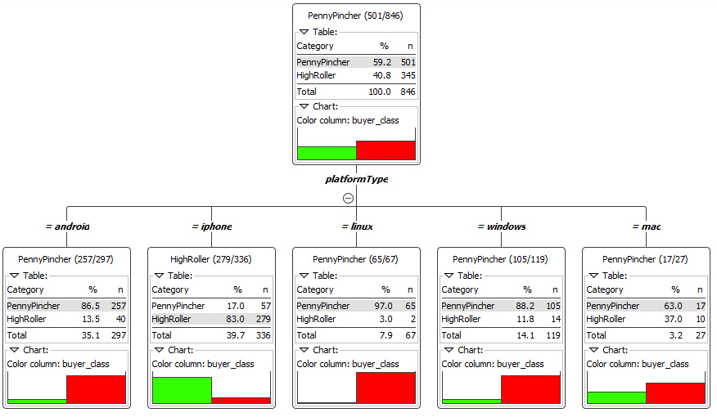
Classification findings
Decision Tree analysis revealed that platform type is a significant predictor in determining whether a player is a high-roller.
iOS has been identified as a valuable platform to promote CTPF, compared to all other platforms.
Notes:
We processed team-level, platform-type, game-clicks count and hit-count data into the KNIME Decision Tree workflow. Discrete training and testing datasets were used to train and validate our model, and findings ultimately point to platform-type as the sole factor to predict the likelihood of a player being a high-roller.
As it turns out, iOS is the platform that yields a high potential for the player to be a high-roller, based on our modeling, which has an 88.5% classification accuracy, based on the historical data that was used.

Slide 7
Clustering findings
Profile | Average buy-click count | Average Expenditure ($) | Average Ad-click count | Cluster size (relative to size of full dataset)
Freeloader | 0.02 | 0.03 | 0.23 | 54.0%
Penny-Pincher | 0.94 | 4.30 | 5.83 | 36.7%
High-Roller | 1.58 | 20.19 | 5.71 | 10.3%
Note: Average values derived from dividing total count by the number of sessions played by user.
High-rollers has propensity to make more than 50% purchases than Penny-Pinchers, and spend 4 to 5 times in absolute amounts too, on a per-session basis.
10% proportion of High-Rollers has potential to grow further.
Notes:
Next, we converted buy-clicks ,expenditure and ad-clicks into average values, and performed a K-means Cluster analysis on this transformed data set.
As you can see here, the Freeloader profile captures the majority of the players who essentially do not spend at all.
Next, we have the Penny-pinchers, who make an average of close to 1 purchase per session, amounting to about $4.30 per transaction.
For High-Rollers, they make almost 1.5 times more purchases that Penny Pinchers, each time spending 4 to 5 times more in absolute amounts per transaction.
It is useful to note that spending players also tend to click on advertisements close to 6 times per session played.
High-Rollers cluster, being only 10% of the whole dataset, definitely has potential to grow larger. Methods could be conceived to try coaxing a certain portion of FreeLoaders to start spending too.

Slide 8
Graph analysis findings on chat data
Top 10 Chattiest Users
User Id | Team Id | No. of Chat Items | Clustering Coeff.
394 | 63 | 115 | 0.75
2067 | 7 | 111 | 0.92
209 | 7 | 109 | 1.00
1087 | 77 | 109 | 0.73
554 | 181 | 107 | 0.80
516 | 52 | 105 | 0.93
1627 | 7 | 105 | 0.93
999 | 7 | 105 | 0.95
668 | 104 | 104 | 1.00
461 | 89 | 104 | 0.83
Top 10 Chattiest Users
Team Id | No. of Chat Items
82 | 1324
185 | 1036
112 | 957
18 | 844
194 | 836
129 | 814
52 | 788
136 | 783
146 | 746
81 | 736
Weak correlation
Chatty teams may not be filled with chatty users, i.e. chatty users can still reside in teams that are not so active in terms of chatter.
Clustering Coefficient is a possible indicator of strong cliques.
Notes:
Neo4j Graph Database was used to investigate the nature of chattiness and connectedness at a user and team level.
It was discovered that chatty users may not hail from chatty teams. As such, in team-chats with less activity, there may be users that chat a lot.
Clustering Coefficient is a measure of closeness amongst a node’s neighbours, and can be used to identify strong cliques.
We can then defined a standard value to identify strong cliques (perhaps values greater or equal to 0.7), then subsequently identify all the chatty users that posesses such a value.
The aim would be to rely on the close social proximity of such chatty users among their peers to help spread the word on certain aspects of the game, such as in-game purchases helping the team as a whole!

Slide 9
Recommendations
Realign marketing resources to promote CTPF on iOS platform.
Increase rewards on iOS version of the game to entice players to provide a review on the App store, hence increasing its rankings within the game category.
Discount on bulk purchase of in-game item Id5 to entice high-rollers to continue spending. Flash-sales on low-priced items to entice Freeloaders to start spending.
Allocate more premium-rate ads to players who make in-game transactions.
Provide rewards to chatty high-rollers to ‘advertise’ their in-game purchases on their team-chats.
Notes:
To conclude, here are some of the recommendations to consider, moving forward:
Shift marketing efforts and resources to promoting CTPF on the iOS platform. The goal here is the grow the player base for iOS, in the high likelihood that they will be highrollers.
Provide slightly better rewards for iOS players to give a review on the App store, so as to improve rankings of CTPF in the game category, which would improve pick-up rate.
Discounts on bulk-purchase of high-priced items, such as item Id5, could incentivise high-rollers to continue spending, or even coax penny-pinchers to try out the high price items. Flash sales on low-priced items can entice Freeloaders to start spending too.
Spenders click up to 6 ads per session, keep that in mind! Start allocating more premium-rate ads to spenders. Shift common-rate ads to the Freeloaders.
Provide a means to share news of in-game purchases to team-chat sessions. Then subsequently target the chatty high-rollers with strong cliques, and provide them a small reward (e.g a low-priced item for free) if they share the news of their purchase in the team-chat. The aim is to use them as influencers to encourage the rest of the team users to buy too, hence ‘contributing to the scoring capability’ of team in a cooperative manner.

Slide 10
End of Presentation

